Slide 1
Bryan Hoff MD
Diplomate American Board of Internal Medicine; Certified Sleep Medicine
Medical Director of the Northfield Sleep Center
Physician at Allina Clinic and Northfield Hospital since 2001
Northfield Resident

Slide 2
What is normal sleep?
It depends on your age

Slide 3
Why do we need to understand normal sleep
Sleep is dependent on schedule
Teens/young adults are fighting nature
School schedules are not linked to normal adolescent sleep
Changing to a later school start can make a notable difference for our teen age students
Schools used to start later and have changed over time

Slide 4
We can make a difference

Slide 5
Factors affecting sleep
Light – this resets the circadian clock daily
Age- sleep drive/pressure changes
Schedule
Mental health state (mental health disorders are disproportionately affected by sleep issues)
Sleep environment
Medical status (pain, disease state)

Slide 6
Circadian Clock
Sleep Drive: it is greatest when we are young.
Sleep requirements- 16 hours in infancy, 9-12 hours in adolescence, 7.5-9 hours in adulthood
Sleep pressure increases the longer we are awake. Thus after approx 13-15 hours most teens are ready to sleep
Our body sends alerting signals to keep us awake and alert. In teens, this is building up over the course of a normal day and peaking approx 12-15 hours later.
So….. In the evening we are generally quite alert as the body is sending out max alerting signals until the sleep drive overcomes this and we fall asleep. SO… sending our kids to bed earlier is not going to gain more sleep

Slide 8
Notice how everything would shift to the right for teens
Teens have their alerting drive increasing later as they go through puberty, from 8 or 9PM to 10 or 11PM. You can see how this would shift their bedtime later. It makes it harder to fall asleep any earlier.
Students do not get a choice on when to get up - school starts at 7:51AM. Working backwards- if you are riding a bus and it takes an hour you are picked up at 6:50AM- given 30 minutes to get ready you are getting up at 6:20. If a teen follows their natural cycle of sleep they fall asleep between 10-11PM and are getting between 7:20-8:20 hours of sleep. Our goal should be for every teen to get over 8 hours minimum with a realistic chance to get 9 hours of sleep

Slide 9
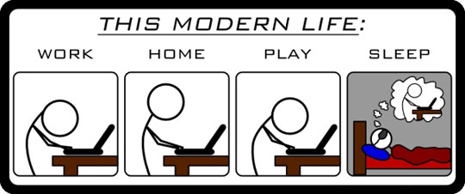
Older data showed: 71 % of 9th graders and 81 % of 12th graders in Ohio get less than 8 hours of sleep

Slide 10
So what happens when your clock is off?
Delayed sleep phase circadian disorder– this is seen most typically in teen-agers. They are not able to fall asleep until later (like 10PM-2AM) but still have to get up for school and start having problems- frequently this is a schedule issue
Their schedule is equivalent to living in California:
In Minnesota going to bed at 11 PM is like going to bed at 9PM in California- where they would get proper sleep
Frequently when allowed to sleep without a schedule teens and young adults will sleep 9-11 hours (a midnight to 11AM schedule is common and may sound familiar to many parents if asked about their teens on week-ends and in the summer)

Slide 11
When the clock is off we see a loss of sleep leading to…
More car crashes
Difficulty with emotion regulation
Difficulty in learning
Increased risky behaviors
Increased tardiness

Slide 12
Schedules have changed
School used to start at 8:30-9:00 am.
National Research Center for Women and Families, (NRC), most schools in the 1950's and 1960's started between 8:30-9:00 a.m. The extremely early starts to the 7:00 hour were the direct result of staggering start times of high schools, middle schools, and elementary schools in order to utilize fewer buses and drivers
My own personal research with multiple people over the age of 70’s, asking when they started, agrees with school start times of 8:30 or later

Slide 13
This can not be just a case of “go to bed earlier”
Hopefully you can now understand why a plan of going to bed earlier will not be successful. It is not bad parenting, it is not a case of our kids not listening. It is a case of our alerting signals changing to a later time. Ask yourself – could I go to bed 1-2 hours before my normal bed time – would I fall asleep? – not likely
If we asked parents to start work at 5:30AM, how many would go to bed at 7:30PM (this would be the 9 hours of sleep we want our kids to have)

Slide 14
Who Supports the need to change our School Start Times?
AASM- American Academy of Sleep Medicine
April 14th 2017 announced they have a position paper on this
https://aasm.org/aasm-position-delaying-middle-school-high-school-start-times-is-beneficial-to-students/
AAP- American Academy of Pediatrics
August 25th 2014, position paper available
https://www.aap.org/en-us/about-the-aap/aap-press-room/pages/let-them-sleep-aap-recommends-delaying-start-times-of-middle-and-high-schools-to-combat-teen-sleep-deprivation.aspx
CDC- Centers for Disease Control
Noted in 2015, 2017 recommended later school start times
https://www.cdc.gov/mmwr/volumes/67/wr/mm6703a1.htm

Slide 15
A website with a list of the many position papers
http://www.startschoollater.net/position-statements.html

Slide 16
Sleep in teenagers
Benefits of good sleep Problems Sleep Deprivation
Better Academics More MVA’s
Better Relationships Increased Depression
Better Health Increased Risky behavior
Better Athletics Increased Tardiness

Slide 17
More teen sleep
=
fewer car crashes and risky behavior

Slide 18
Safety- MVA
https://www.ncbi.nlm.nih.gov/pmc/articles/PMC2603528/ 1999 Data out of Kentucky
https://aasm.org/teens-with-earlier-school-start-times-have-higher-crash-rates/ 2009-2010 Virginia

Slide 19
Better academic testing- specifically better math scores
Air Force academy study- http://old.econ.ucdavis.edu/faculty/scarrell/sleep.pdf
Review of Studies - https://www.ncbi.nlm.nih.gov/pmc/articles/PMC4824552/ Review of 38 studies- no negative attribution from later school start. Not all showed academic improvement but as an aggregate improvement in all areas listed previously in this talk as benefits

Slide 20
Sleep benefits learning and memory
Lack of sleep impairs both the ability to acquire new knowledge (learning) and the ability to remember it later on (memory consolidation)

Slide 21
Enhanced concentration
http://healthysleep.med.harvard.edu/healthy/matters/benefits-of-sleep/learning-memory

Slide 22
Tardiness
Students come late, why- they have difficulty in waking up
http://www.apa.org/monitor/2016/02/sleep-deprived.aspx
Kyla Wahlstrom 2014
https://journals.lww.com/co-psychiatry/Citation/2017/11000/School_start_time_effects_on_adolescent_learning.15.aspx

Slide 23
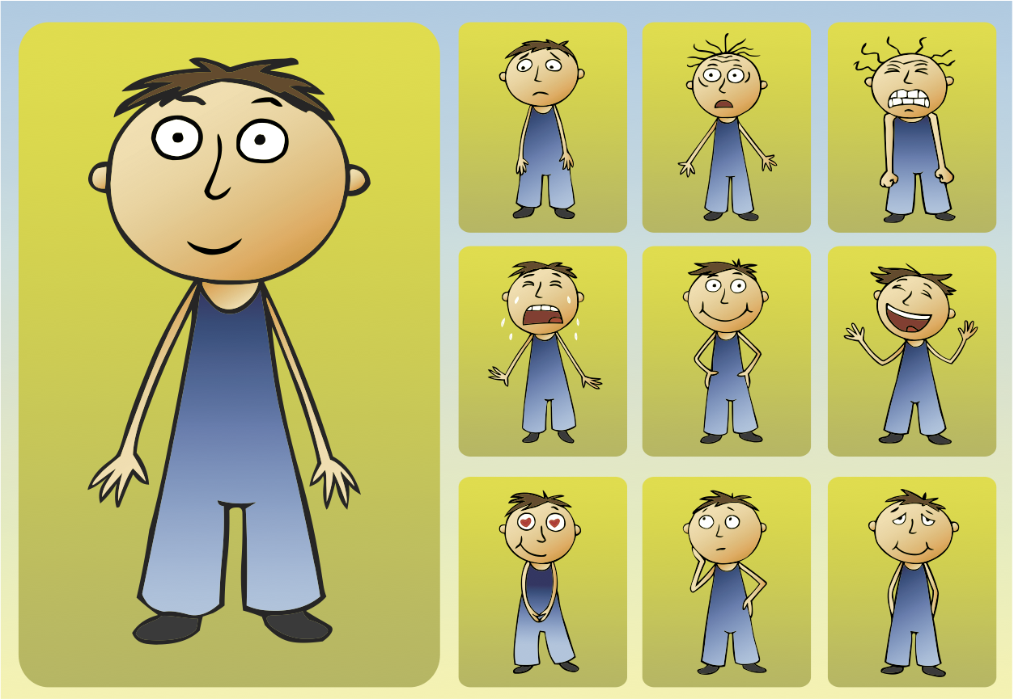
Better Mental Health
Sleep benefits emotion regulation
Already a difficult task in adolescence
Key for social relationships, stress management and mood

Slide 24
Better Mental Health
Decreased Depression
https://teensneedsleep.files.wordpress.com/2011/03/fuligini_hardway-adolescent-sleep.pdf
The daily assessments of adolescents’ sleep that were obtained in this study suggest several insights to be added to our growing understanding about the significance of sleep in adolescents’ lives. First, adolescents’ sleep time is highly variable across individual days in addition to the previously known difference in sleep time between weekdays and week- ends. Second, the variability in adolescents’ sleep time is just as important as the average amount of sleep in explaining individual differences in daily psychological well-being. Third, studying and stressful demands are among the most important factors that can reduce the amount of sleep that adolescents receive at night. Fourth, daily feelings of anxiety, depression, and fatigue are the most consistent psychological outcomes of obtaining less sleep at night. Finally, a degree of individual variability exists in some of the dynamics of daily sleep, activities, and psychological well-being among adolescents. Variability in both the daily patterns and the implications of sleep should be a key focus in future research on the role of sleeping behaviors in adolescent development.
https://www.ncbi.nlm.nih.gov/pubmed/25134876 Abstract connecting sleep and psychiatric illnesses

Slide 25
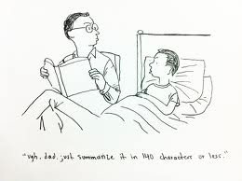
Findings in Edina
Students in Edina reported statistically significant less depression compared with two similar districts
School counselors and nurses reported fewer students seeing help for emotional problems and somatic physical complaints
92% of parents in Edina said their teenagers were “easier to live with”

Slide 26
Better Health
Fewer illness/tardiness/ Decreased obesity
http://healthysleep.med.harvard.edu/need-sleep/whats-in-it-for-you/health

Slide 27
Increased Risky behavior
Lack of sleep leads to poor impulse control- greater risk to drink caffeine, smoke and ultimately try drugs
Remember teenagers already have impulse control but with lack of sleep this gets worse
https://www.cdc.gov/features/school-start-times/index.html

Slide 28
A great article by the lead researcher at the University of Minnesota (And one of the reasons I became an advocate)
http://www.kappanonline.org/later-start-time-for-teens/
Do a google search and see the many articles in New York Times, Time, The Atlantic, Breitbart, CBS, NBC, LA Times etc

Slide 29
How do we pick a time
Studies show teens need 9-9.5 hours of sleep
How do we choose the start time? First, the average time for an adolescent to go to bed is 10-11PM. They need a minimum of 8 hours sleep and the goal is 9 hours, so that would mean a wake up time of approximately 7AM. They get 30 minutes to wake up, eat and get ready, so 7:30AM would be the earliest bus stop time. The longest bus is about 1-1:15 hours long and you add that to 7:30 AM and you get a start time of 8:45-9AM ideally for middle and high school.
This would look a lot like Wednesdays, but school would go to 3:45

Slide 30
Challenges
Change itself
Busing schedules (drop off times in the dark)
Parents who are adversely affected (like those who work early and commute)
Afterschool activities
Teachers

Slide 31
Ambient light for bus stops
Civil Twilight: the time at which the sun is 6 degrees below the horizon. At this time, there is enough light for objects to be clearly distinguishable and that outdoor activities can commence (dawn) or end (dusk) without artificial illumination. Civil twilight is the definition of twilight most widely used by the general public

Slide 32
Ambient light for evening bus stops
Nov 16th Sunset: 4:45 pm Twilight 5:17 pm
Dec 5th Sunset: 4:34pm Twilight 5:06pm
Dec 14th Sunset 4:33pm Twilight 5:07Ppm
Jan 3rd Sunset 4:45pm Twilight 5:18 pm

Slide 33
